Slide 1


HASIL PENELITIAN KAPASITAS ADSORPSI FE-BDC
Nama : Areski Febriani
NPM : A2L020009
PU: Prof. Dr. M. Lutfi Firdaus, M.T
PP: Dr. Euis Nursa’adah, M. Pd
PASCASARJANA S2 PENDIDIKAN IPA
UNIVERSITAS BENGKULU
2022
BAB - 1
BAB - 2
BAB - 3
BAB - 4
BAB - 5

Slide 2
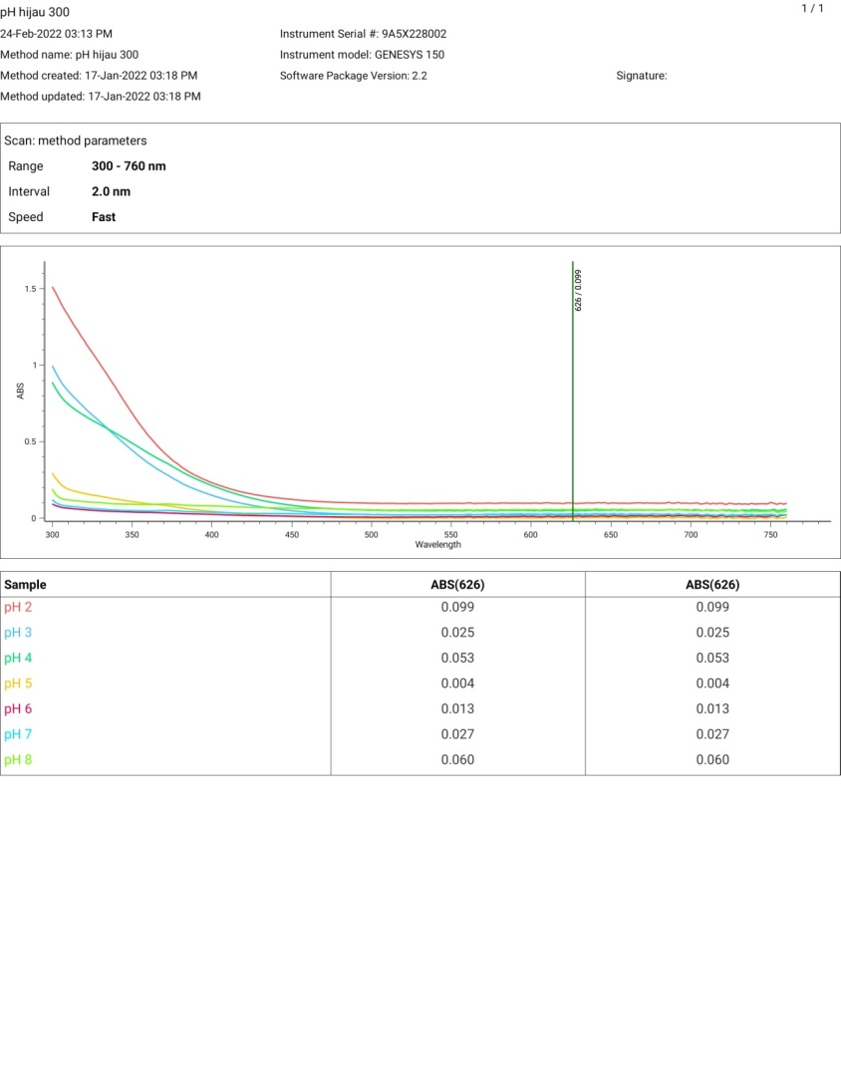
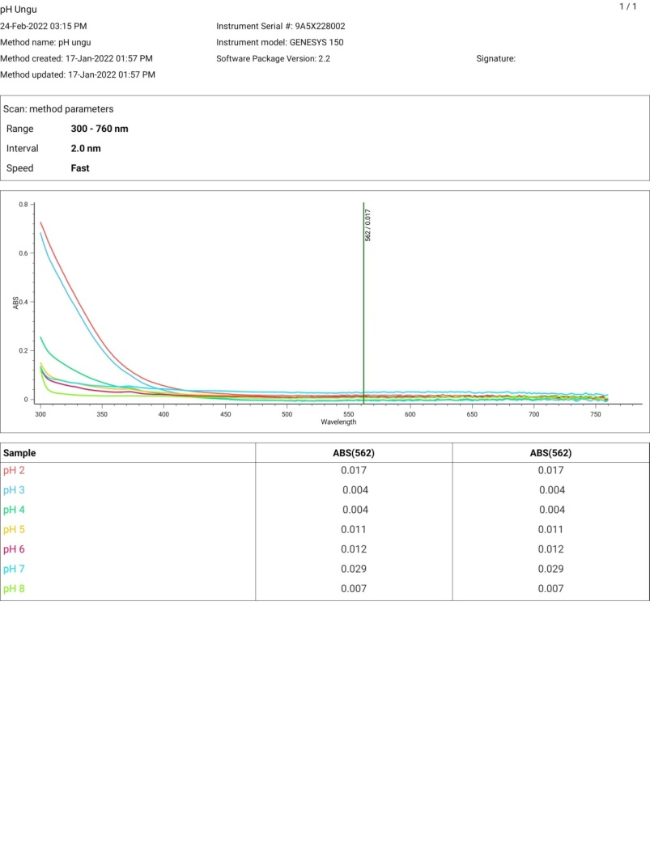
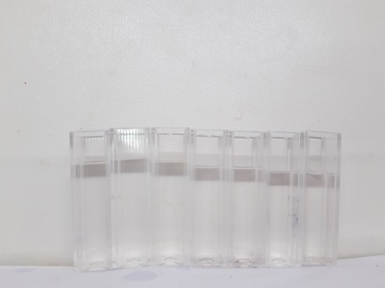
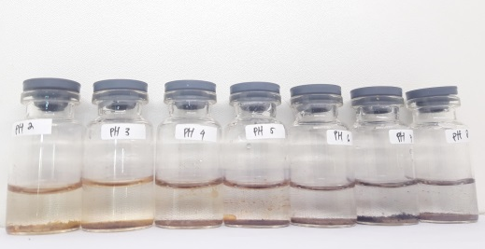
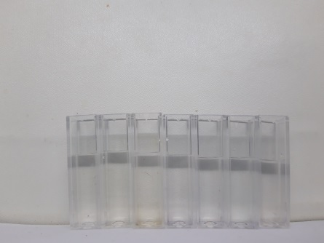
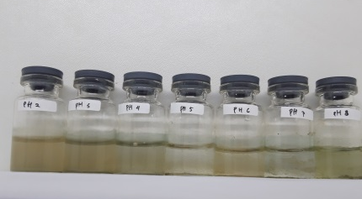
BAB - 1
BAB - 2
BAB - 3
BAB - 4
BAB - 5
VV
HASIL PENELITIAN DAN PEMBAHASAN
pH OPTIMUM

Slide 3
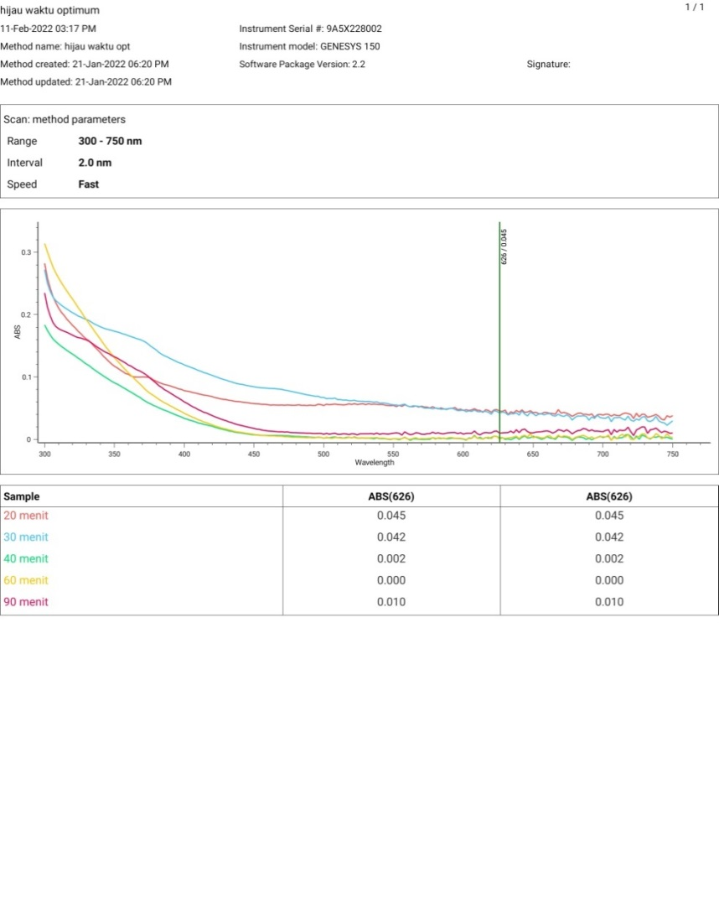
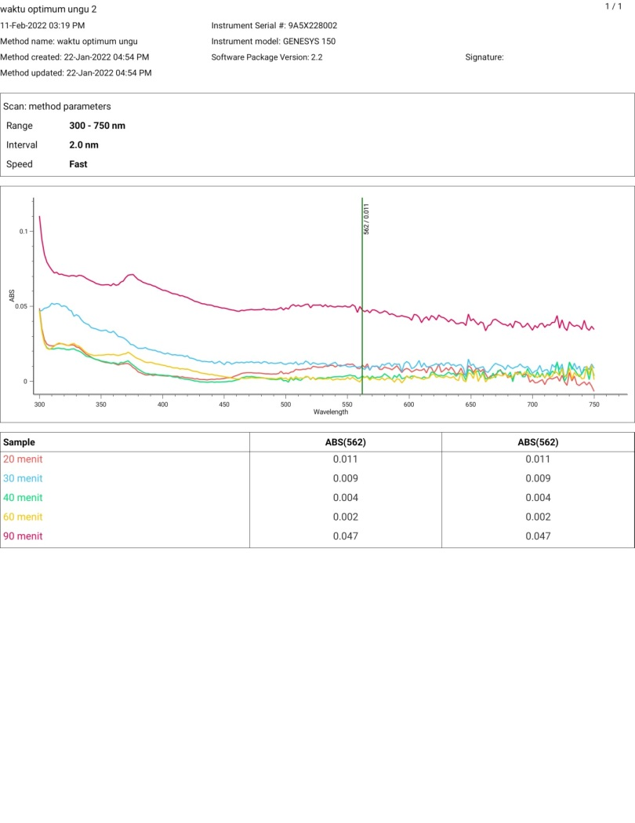
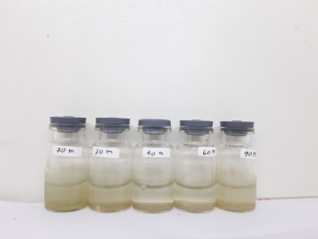
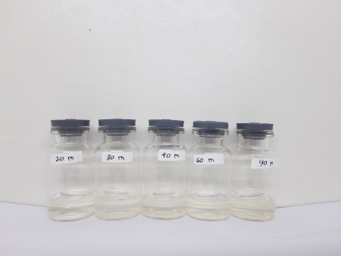
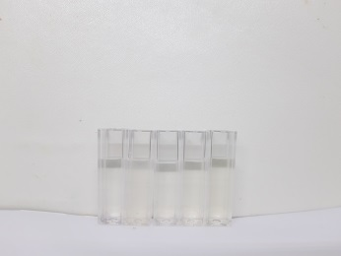
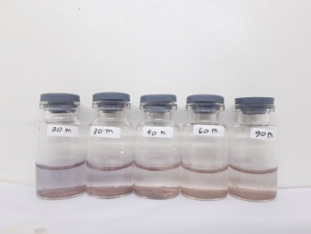
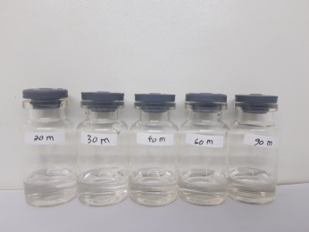
BAB - 1
BAB - 2
BAB - 3
BAB - 4
BAB - 5
HASIL PENELITIAN DAN PEMBAHASAN
WAKTU OPTIMUM

Slide 4
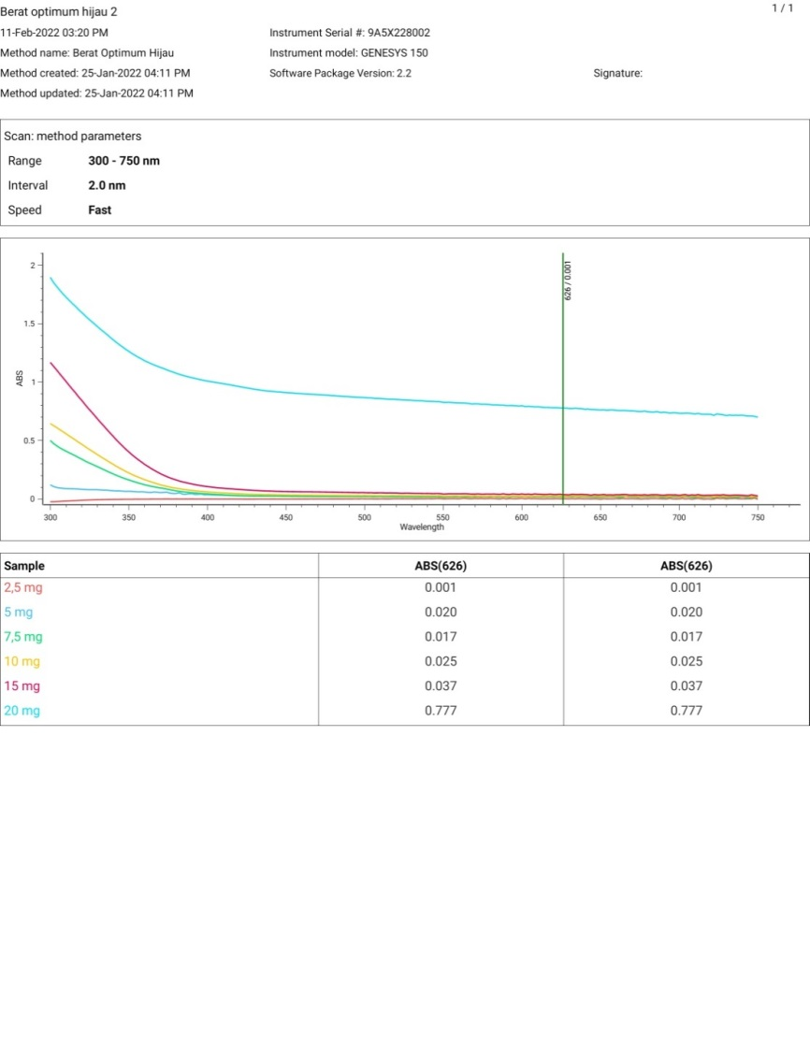
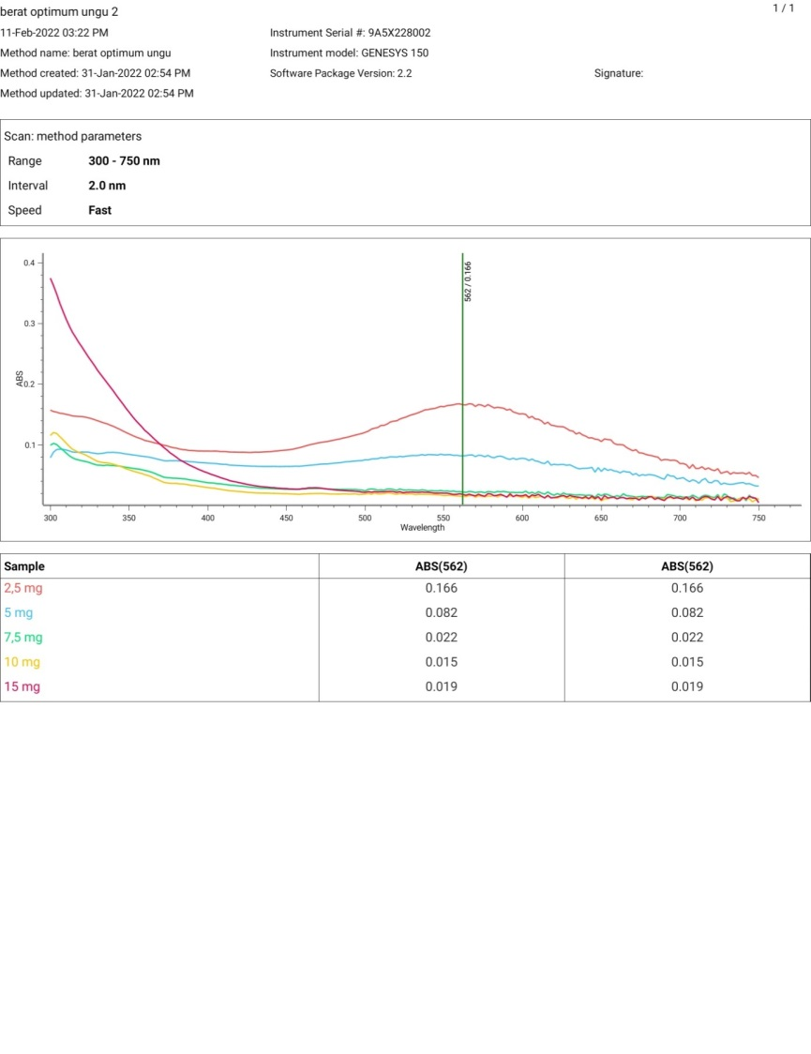
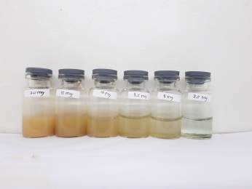
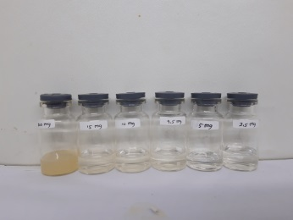
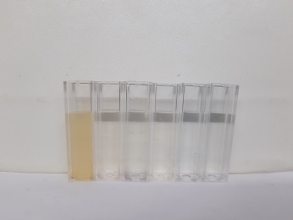
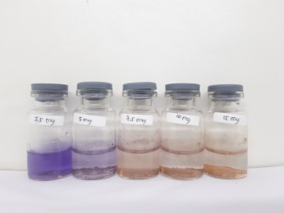
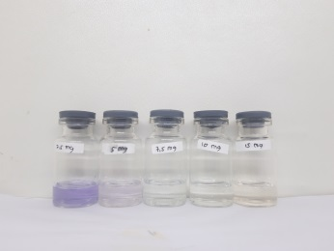
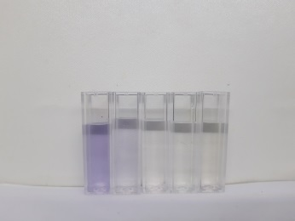
BAB - 1
BAB - 2
BAB - 3
BAB - 4
BAB - 5
HASIL PENELITIAN DAN PEMBAHASAN
BERAT OPTIMUM

Slide 5
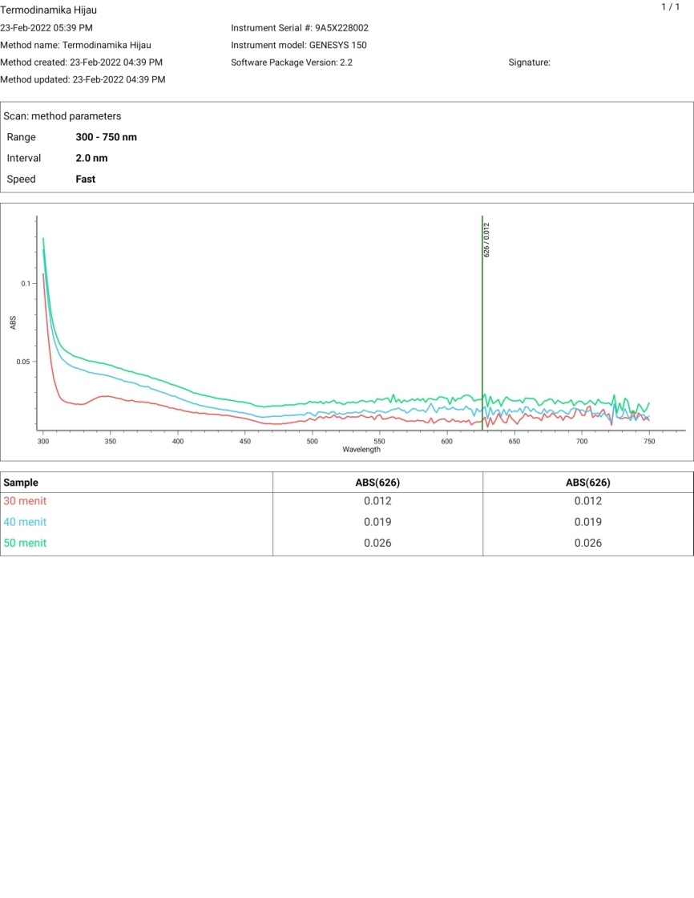
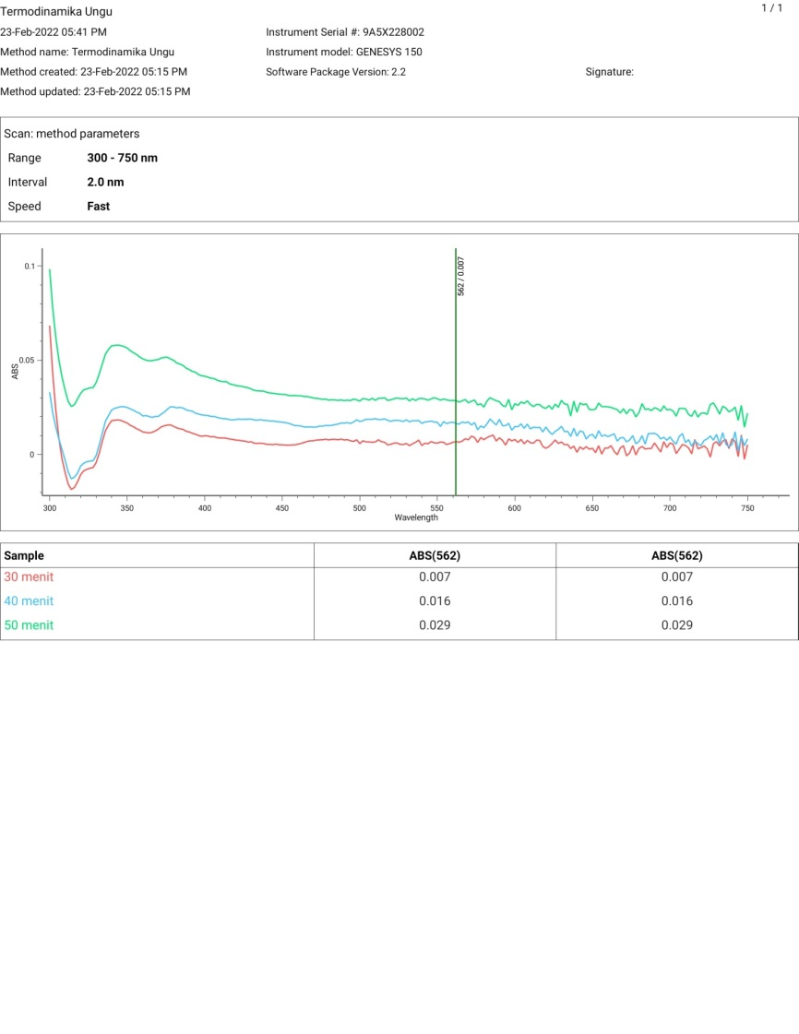
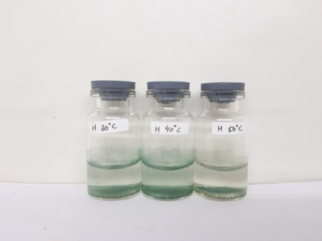
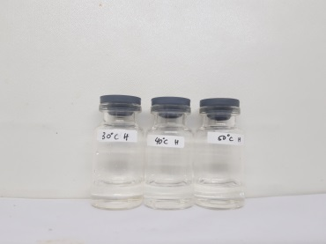
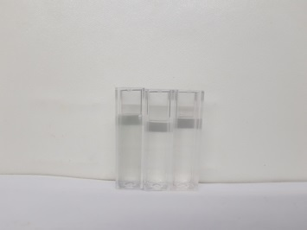
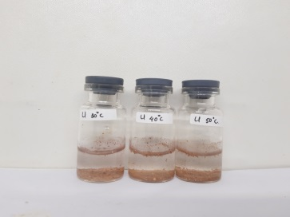
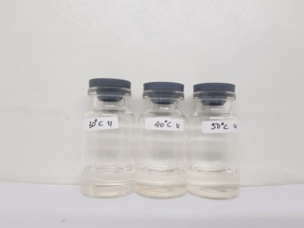
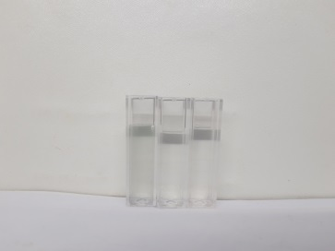
BAB - 1
BAB - 2
BAB - 3
BAB - 4
BAB - 5
HASIL PENELITIAN DAN PEMBAHASAN
SUHU OPTIMUM

Slide 6
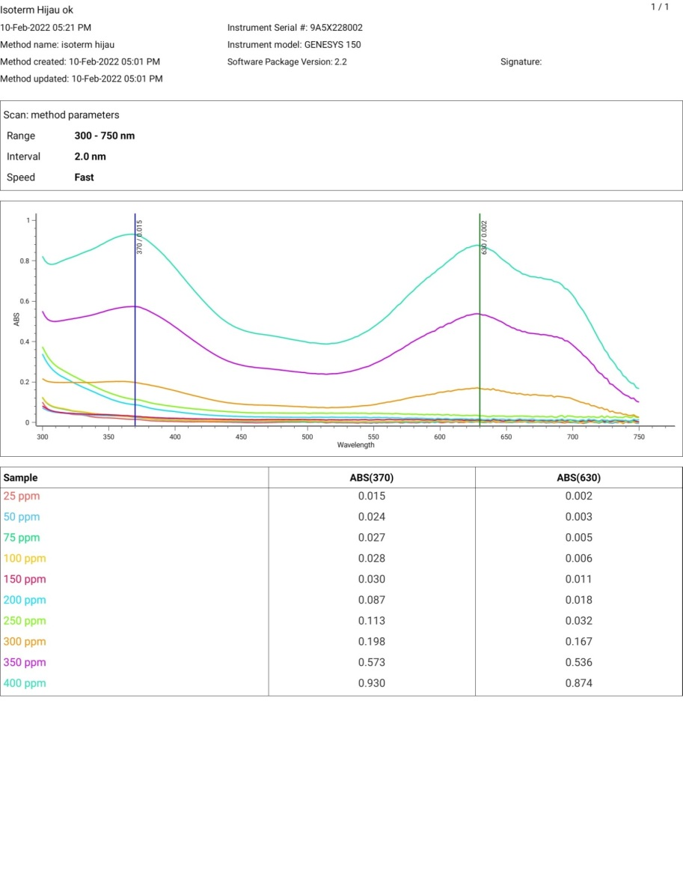
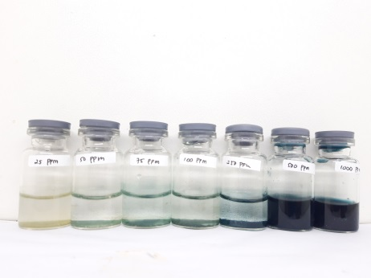
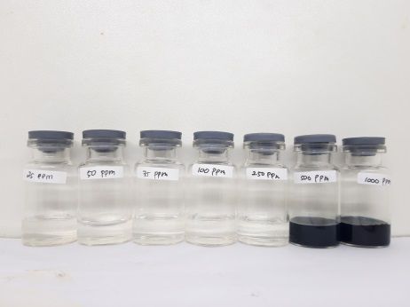
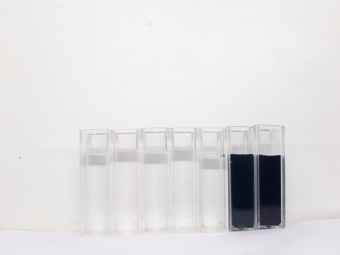
BAB - 1
BAB - 2
BAB - 3
BAB - 4
BAB - 5
HASIL PENELITIAN DAN PEMBAHASAN
ISOTERM MALACHITE GREEN

Slide 7
BAB - 1
BAB - 2
BAB - 3
BAB - 4
BAB - 5
HASIL PENELITIAN DAN PEMBAHASAN
ISOTERM MALACHITE GREEN
A | C awal | C akhir | C terserap | Efisiensi | Q | Log C akhir | Log Q | C akhir/Q
0,0022 | 25 | 0,793 | 24,207 | 96,826 | 48,413 | -0,100 | 1,685 | 0,016
0,0034 | 50 | 0,922 | 49,078 | 98,157 | 98,157 | -0,035 | 1,992 | 0,009
0,0045 | 75 | 1,043 | 73,957 | 98,609 | 147,913 | 0,018 | 2,170 | 0,007
0,0063 | 100 | 1,241 | 98,759 | 98,759 | 197,517 | 0,094 | 2,296 | 0,006
0,0108 | 150 | 1,724 | 148,276 | 98,851 | 296,552 | 0,237 | 2,472 | 0,006
0,0176 | 200 | 2,464 | 197,536 | 98,768 | 395,072 | 0,392 | 2,597 | 0,006
0,0318 | 250 | 4,008 | 245,992 | 98,397 | 491,985 | 0,603 | 2,692 | 0,008
0,1672 | 300 | 18,725 | 281,275 | 93,758 | 562,550 | 1,272 | 2,750 | 0,033
0,5359 | 350 | 58,808 | 291,192 | 83,198 | 582,385 | 1,769 | 2,765 | 0,101
0,8737 | 400 | 95,524 | 304,476 | 76,119 | 608,952 | 1,980 | 2,785 | 0,157
Parameter Langmuir |  |  | Parameter Freundlinch |  |  | Langmuir |  | Freundlich
Kl | Qmax | R2 | Kf | n | R2 | m | 0,0016 | m | 0,3843
0,2857 | 625,00 | 0,9943 | 151,6701 | 2,6021 | 0,6259 | c | 0,0056 | c | 2,1809

Slide 8
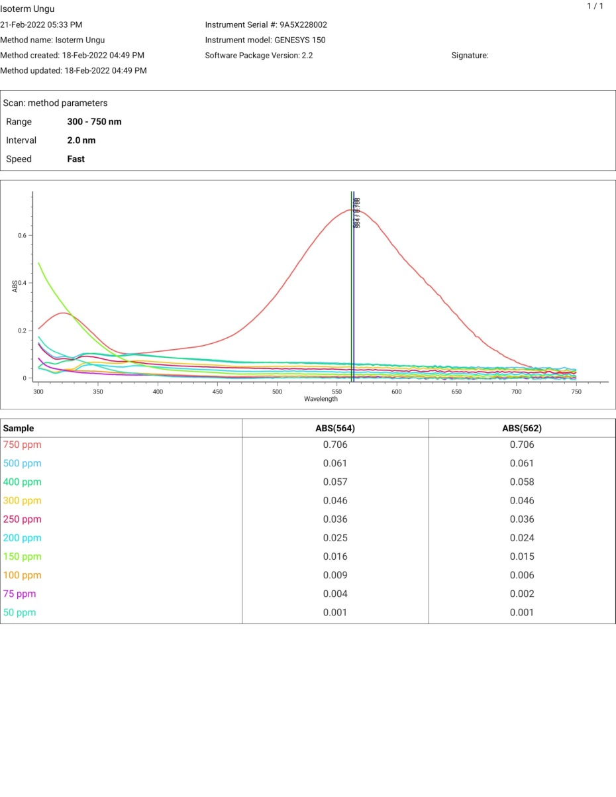
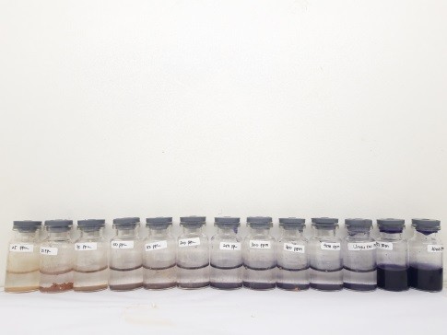
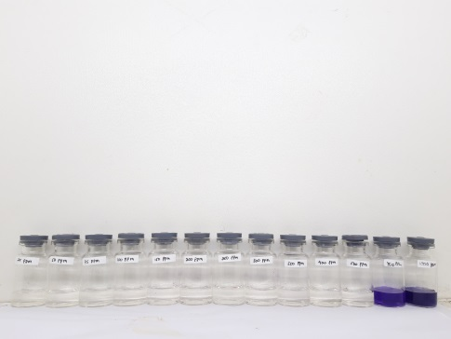
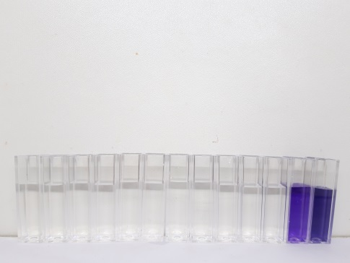
BAB - 1
BAB - 2
BAB - 3
BAB - 4
BAB - 5
HASIL PENELITIAN DAN PEMBAHASAN
ISOTERM VIOLET DYE

Slide 9
BAB - 1
BAB - 2
BAB - 3
BAB - 4
BAB - 5
HASIL PENELITIAN DAN PEMBAHASAN
ISOTERM VIOLET DYE
A | C awal | C akhir | C terserap | Efisiensi | Q | Log C akhir | Log Q | C akhir/Q
0,0011 | 50 | 0,677 | 49,323 | 98,645 | 24,661 | -0,169 | 1,392 | 0,027
0,0023 | 75 | 0,786 | 74,214 | 98,951 | 37,107 | -0,104 | 1,569 | 0,021
0,0062 | 100 | 1,137 | 98,863 | 98,863 | 49,432 | 0,056 | 1,694 | 0,023
0,0153 | 150 | 1,957 | 148,043 | 98,695 | 74,022 | 0,292 | 1,869 | 0,026
0,0241 | 200 | 2,751 | 197,249 | 98,624 | 98,624 | 0,440 | 1,994 | 0,028
0,0340 | 250 | 3,635 | 246,365 | 98,546 | 123,182 | 0,561 | 2,091 | 0,030
0,0456 | 300 | 4,683 | 295,317 | 98,439 | 147,659 | 0,671 | 2,169 | 0,032
0,0578 | 400 | 5,780 | 394,220 | 98,555 | 197,110 | 0,762 | 2,295 | 0,029
0,0609 | 500 | 6,060 | 493,940 | 98,788 | 246,970 | 0,782 | 2,393 | 0,025
0,7063 | 750 | 64,204 | 685,796 | 91,440 | 342,898 | 1,808 | 2,535 | 0,187
Parameter Langmuir |  |  | Parameter Freundlinch |  |  | Langmuir |  | Freundlich
Kl | Qmax | R2 | Kf | n | R2 | m | 0,0026 | m | 0,5947
0,1368 | 384,6154 | 0,9921 | 49,7737 | 1,6815 | 0,8474 | c | 0,019 | c | 1,697

Slide 10
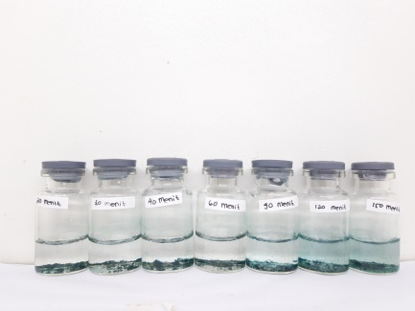
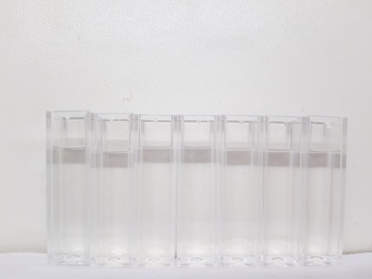
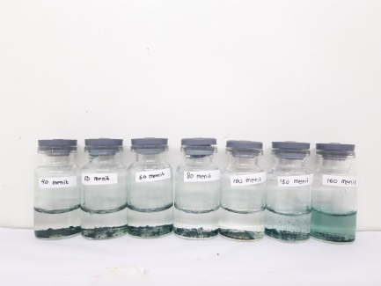
BAB - 1
BAB - 2
BAB - 3
BAB - 4
BAB - 5
HASIL PENELITIAN DAN PEMBAHASAN
KINETIKA MALACHITE GREEN
Malachite Green (Hijau) 50 pppm
Pseudo orde 1 |  |  | Pseudo orde 2
k1 | qe | R2 | k2 | qe | R2
0,0005 | 4,0626 | 0,9758 | 0,0351 | 0,3264 | 0,9939
Malachite Green (Hijau) 100 pppm
Pseudo orde 1 |  |  | Pseudo orde 2
k1 | qe | R2 | k2 | qe | R2
0,0002 | 8,1527 | 0,9530 | 0,0225 | 0,4430 | 0,9720

Slide 11
BAB - 1
BAB - 2
BAB - 3
BAB - 4
BAB - 5
HASIL PENELITIAN DAN PEMBAHASAN
KINETIKA MALACHITE GREEN
Waktu | A | C awal | C akhir | C terserap | Efisiensi | qe | qt | t/qt | log (qe-qt)
20 | 0,002 | 50 | 0,772 | 49,228 | 98,457 | 4,102 | 0,064 | 310,986 | 0,606
30 | 0,004 | 50 | 1,010 | 48,990 | 97,980 | 4,083 | 0,084 | 356,512 | 0,602
40 | 0,006 | 50 | 1,207 | 48,793 | 97,587 | 4,066 | 0,101 | 397,838 | 0,598
60 | 0,009 | 50 | 1,533 | 48,467 | 96,935 | 4,039 | 0,128 | 469,787 | 0,592
90 | 0,013 | 50 | 1,967 | 48,033 | 96,065 | 4,003 | 0,164 | 548,950 | 0,584
120 | 0,016 | 50 | 2,293 | 47,707 | 95,413 | 3,976 | 0,191 | 627,867 | 0,578
150 | 0,018 | 50 | 2,490 | 47,510 | 95,020 | 3,959 | 0,208 | 722,828 | 0,574
Waktu | A | C awal | C akhir | C terserap | Efisiensi | qe | qt | t/qt | log (qe-qt)
40 | 0,008 | 100 | 1,424 | 98,576 | 98,576 | 8,215 | 0,119 | 337,099 | 0,908
50 | 0,012 | 100 | 1,859 | 98,141 | 98,141 | 8,178 | 0,155 | 322,807 | 0,904
60 | 0,014 | 100 | 2,076 | 97,924 | 97,924 | 8,160 | 0,173 | 346,806 | 0,902
80 | 0,017 | 100 | 2,402 | 97,598 | 97,598 | 8,133 | 0,200 | 399,638 | 0,899
100 | 0,018 | 100 | 2,511 | 97,489 | 97,489 | 8,124 | 0,209 | 477,922 | 0,898
130 | 0,023 | 100 | 3,054 | 96,946 | 96,946 | 8,079 | 0,255 | 510,747 | 0,893
160 | 0,025 | 100 | 3,272 | 96,728 | 96,728 | 8,061 | 0,273 | 586,844 | 0,891

Slide 12
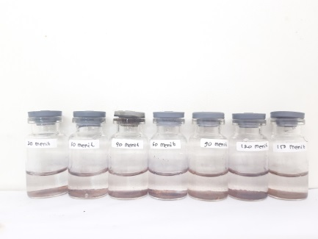
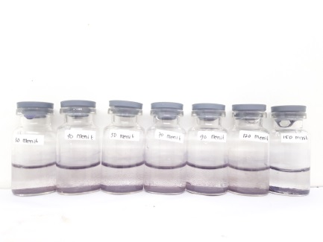
BAB - 1
BAB - 2
BAB - 3
BAB - 4
BAB - 5
HASIL PENELITIAN DAN PEMBAHASAN
KINETIKA VIOLET DYE
Violet Dye (Ungu) 50 pppm
Pseudo orde 1 |  |  | Pseudo orde 2
k1 | qe | R2 | k2 | qe | R2
0,0005 | 1,2711 | 0,9614 | 0,0175 | 0,5217 | 0,9913
Violet Dye (Ungu) 100 pppm
Pseudo orde 1 |  |  | Pseudo orde 2
k1 | qe | R2 | k2 | qe | R2
0,0005 | 12,2800 | 0,9593 | 0,0126 | 0,7237 | 0,9904

Slide 13
BAB - 1
BAB - 2
BAB - 3
BAB - 4
BAB - 5
HASIL PENELITIAN DAN PEMBAHASAN
KINETIKA VIOLET DYE
Waktu | A | C awal | C akhir | C terserap | Efisiensi | qe | qt | t/qt | log (qe-qt)
20 | 0,001 | 50 | 0,667 | 49,333 | 98,667 | 6,167 | 0,083 | 240,000 | 0,784
30 | 0,003 | 50 | 0,847 | 49,153 | 98,306 | 6,144 | 0,106 | 283,404 | 0,781
40 | 0,006 | 50 | 1,117 | 48,883 | 97,766 | 6,110 | 0,140 | 286,452 | 0,776
60 | 0,010 | 50 | 1,477 | 48,523 | 97,045 | 6,065 | 0,185 | 324,878 | 0,769
90 | 0,015 | 50 | 1,928 | 48,072 | 96,144 | 6,009 | 0,241 | 373,458 | 0,761
120 | 0,018 | 50 | 2,198 | 47,802 | 95,604 | 5,975 | 0,275 | 436,721 | 0,756
150 | 0,020 | 50 | 2,378 | 47,622 | 95,243 | 5,953 | 0,297 | 504,545 | 0,752
Waktu | A | C awal | C akhir | C terserap | Efisiensi | qe | qt | t/qt | log (qe-qt)
30 | 0,008 | 100 | 1,297 | 98,703 | 98,703 | 12,338 | 0,162 | 185,000 | 1,085
40 | 0,011 | 100 | 1,568 | 98,432 | 98,432 | 12,304 | 0,196 | 204,138 | 1,083
50 | 0,014 | 100 | 1,838 | 98,162 | 98,162 | 12,270 | 0,230 | 217,647 | 1,081
70 | 0,018 | 100 | 2,198 | 97,802 | 97,802 | 12,225 | 0,275 | 254,754 | 1,077
90 | 0,023 | 100 | 2,649 | 97,351 | 97,351 | 12,169 | 0,331 | 271,837 | 1,073
120 | 0,028 | 100 | 3,099 | 96,901 | 96,901 | 12,113 | 0,387 | 309,767 | 1,069
150 | 0,032 | 100 | 3,459 | 96,541 | 96,541 | 12,068 | 0,432 | 346,875 | 1,066

Slide 14

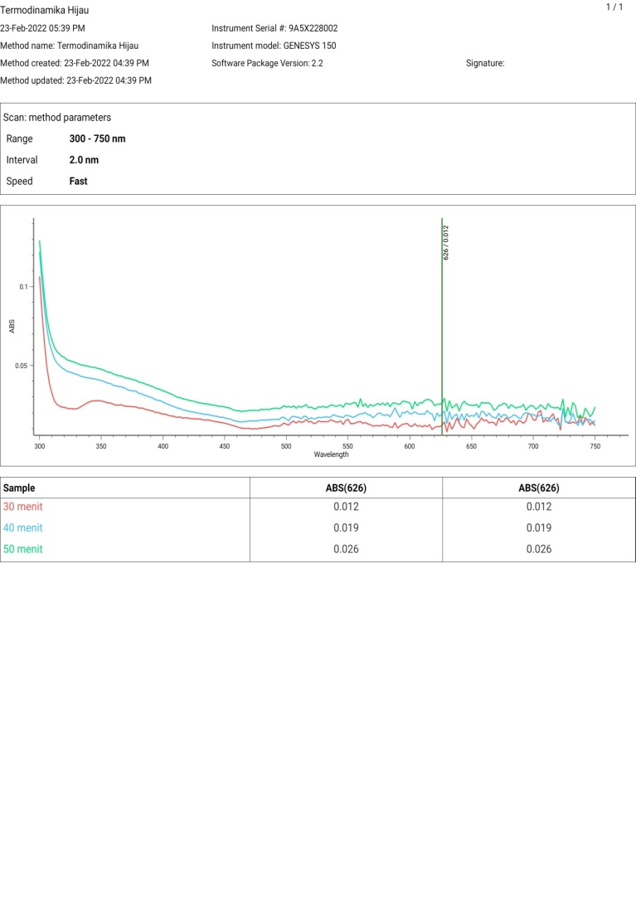


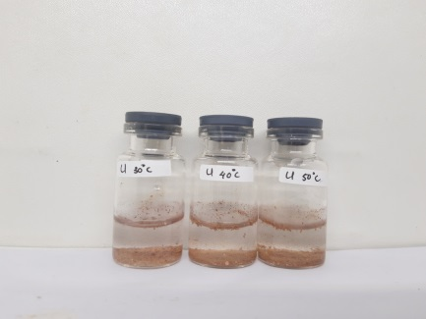
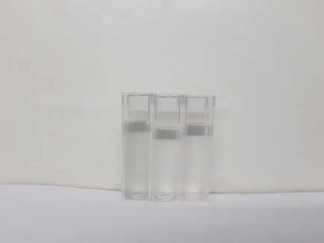
BAB - 1
BAB - 2
BAB - 3
BAB - 4
BAB - 5
HASIL PENELITIAN DAN PEMBAHASAN
TERMODINAMIKA

Slide 15
BAB - 1
BAB - 2
BAB - 3
BAB - 4
BAB - 5
HASIL PENELITIAN DAN PEMBAHASAN
TERMODINAMIKA
Suhu | 1/T | ln kd | ΔG (Kj/mol) | ΔH (Kj/mol) | ΔS (Kj/mol.K)
303 | 0,0033 | 3,9498 | -9,9502 | -18,1661 | 0,3178 | 0,3030
313 | 0,0032 | 3,5805 | -9,3175 |  | 0,3026
323 | 0,0031 | 3,3179 | -8,9098 |  | 0,2887
MALACHITE GREEN
Suhu | 1/T | ln kd | ΔG (Kj/mol) | ΔH (Kj/mol) | ΔS (Kj/mol.K)
303 | 0,0033 | 3,0115 | -7,5864 | 0,0301 | 0,0805 | 0,0765
313 | 0,0032 | 2,4535 | -6,3846 |  | 0,0766
323 | 0,0031 | 2,0056 | -5,3860 |  | 0,0725
VIOLET DYE

Slide 16
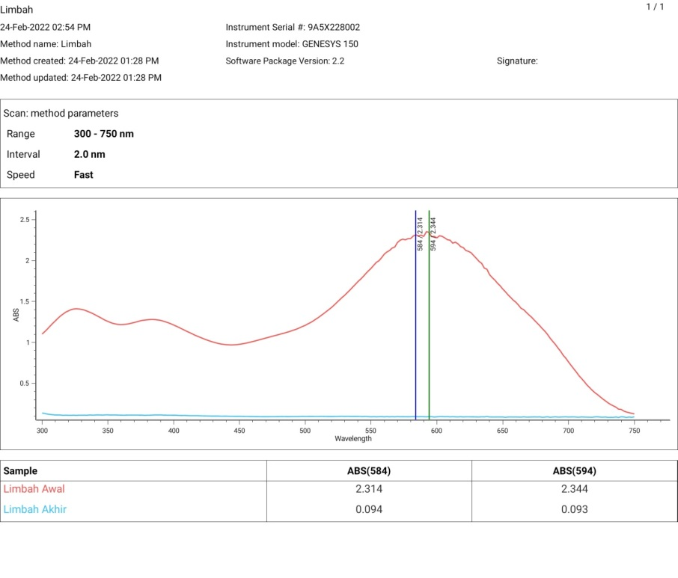
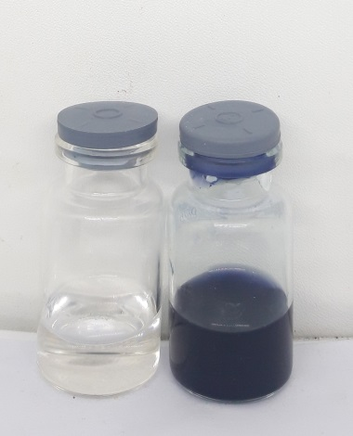
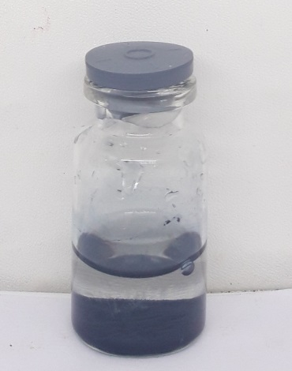
BAB - 1
BAB - 2
BAB - 3
BAB - 4
BAB - 5
HASIL PENELITIAN DAN PEMBAHASAN
LIMBAH
Kondisi Optimum | A Awal | A Akhir | C awal (ppm) | C akhir (ppm) | C terserap (ppm) | Efisiensi (%) | q (mg/g)
Hijau | 2,095 | 0,091 | 233,854 | 8,685 | 225,169 | 96,286 | 112,584
Ungu | 2,105 | 0,094 | 234,978 | 9,022 | 225,955 | 96,622 | 112,978

Slide 17


1
............................................................................
............................................................................
............................................................................
............................................................................
...................................... ......................................
......................................
......................................
......................................
......................................
......................................
......................................
.............................................................................................
.............................................................................................
.............................................................................................

